Slide 1


Slide 2
Linkerd
What is Linkerd?
A service mesh. It adds observability, reliability, and security to Kubernetes applications without code changes. For example, Linkerd can monitor and report per-service success rates and latencies, can automatically retry failed requests, and can encrypt and validate connections between services, all without requiring any modification of the application itself. Linkerd is built for security from the ground up, ranging from features like on-by-default mTLS, a data plane that is built in a Rust, memory-safe language, and regular security audits. Finally, Linkerd has publicly committed to open governance and is hosted by the CNCF.

Slide 3
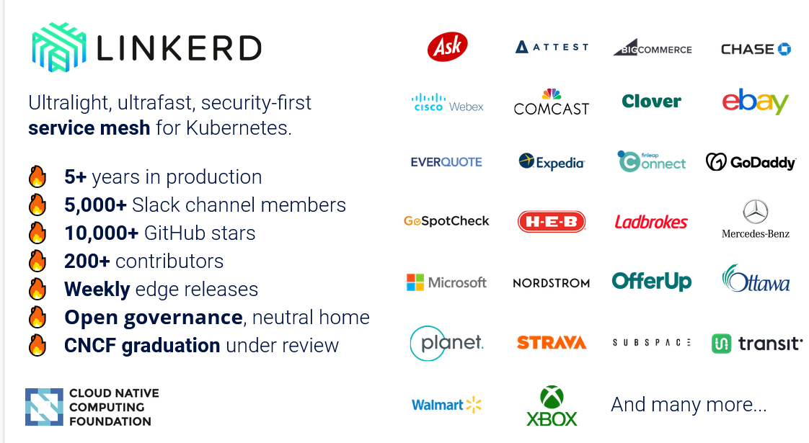
A Bouyant and CNCF project

Slide 4
Attributes of quality
Observability
Service-level golden metrics: success rates, latencies, throughput. Service topologies
Reliability
Retries, timeouts, load balancing, circuit breaking*
Security
Security: Transparent mTLS, cert management and rotation, policy*
In an ultralight package focused on operational simplicity first and foremost.

Slide 5
Overview
How is it pronounced?
Linkerd rhymes with “Cardi B”. The “d” is pronounced separately, as in “Linker-DEE”.
Linkerd has a control plane and a data plane, and uses a proxy is a component of the data plane.
Linkerd uses an ultralight “micro-proxy” called Linkerd2-proxy, which is built in Rust for safety and performance.
Linkerd2-proxy that is built specifically for the service mesh sidecar use case. This allows Linkerd to be significantly smaller and simpler than Envoy-based service meshes. The choice of Rust also allows Linkerd to avoid a whole class of CVEs and vulnerabilities that can impact proxies written in non-memory-safe languages like C++.
Two parallel branches of development:
Linkerd 2.x: ultralight, zero-config, Kubernetes-first (active)
Linkerd 1.x: JVM-based and multi-platform (maintenance)

Slide 6

Why should I care?
Linkerd gives ...
... platform owners (SREs, architects)
... the observability, reliability, and security primitives
... that are critical for cloud native architectures
... with no developer involvement!
Linkerd doesn't just solve technical problems, it solves social problems. It gives platform owners control over their destiny by decoupling them from developers.

Slide 7

How is Linkerd designed?
Do less, not more:
Just works: Zero config, out of the box, for any Kubernetes app
Ultralight: Introduce the bare minimum perf and resource cost
Simple: Reduce operational complexity in every possible way
Security out of the box: make security the default, not the extra add-on.
Control plane: Go. ~200mb footprint. (github.com/linkerd/linkerd2).
Data plane: Rust. <20mb footprint, <1ms p99 (github.com/linkerd/linkerd2-proxy)
Background reading: Linkerd v2: How Lessons from Production Adoption Resulted in a Rewrite of the Service Mesh (InfoQ)

Slide 8
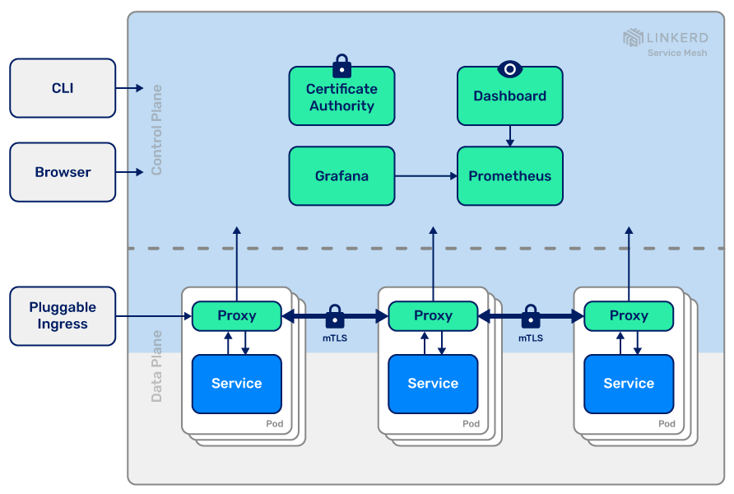



Linkerd 2.x architecture
The control plane is a set of services that run in a dedicated namespace. These services accomplish various things—aggregating telemetry data, providing a user-facing API, providing control data to the data plane proxies, etc. Together, they drive the behavior of the data plane.
The data plane consists of transparent proxies that are run next to each service instance. These proxies automatically handle all traffic to and from the service. Because they’re transparent, these proxies act as highly instrumented out-of-process network stacks, sending telemetry to, and receiving control signals from, the control plane.

Slide 9
What does Linkerd use for its data plane?
A "micro-proxy" called simply Linkerd2-proxy. (Not Envoy!)
Security first: Rust lets us avoid an entire class of memory vulnerabilities.
Ultralight, ultrafast: Rust compiles to native code. No runtime env/GC!
State-of-the art network stack: Built on Tokio, Hyper, H2, Tower, and the rest of the modern Rust async networking stack.
Philosophy: proxy should be an implementation detail. You should not have to become an operational expert in the proxy just to operate the service mesh! (See Why Linkerd Doesn't Use Envoy for more.)

Slide 10
What is Linkerd's approach to security?
Linkerd follows a strict philosophy when it comes to security:
Secure the foundations. E.g. Rust for Linkerd2-proxy.
Build on top of Kubernetes. E.g. ServiceAccounts for pod identity.
Remove barriers to entry. E.g. mTLS is on by default.
Complexity is the enemy of security. Reduce configuration, turn it all on by default, and don't make users have to work for security.
Full audit here: https://github.com/linkerd/linkerd2/blob/master/SECURITY_AUDIT.pdf

Slide 11
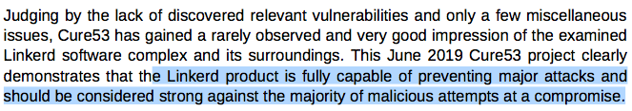
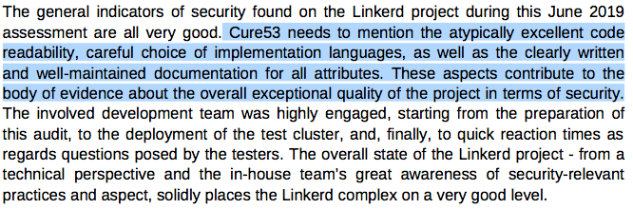
Security audit result
How fast is it?
Tl;dr: really fast. Not as fast as "no service mesh", but significantly smaller and faster than Istio.
Source: https://kinvolk.io/blog/2019/05/performance-benchmark-analysis-of-istio-and-linkerd/

Slide 12
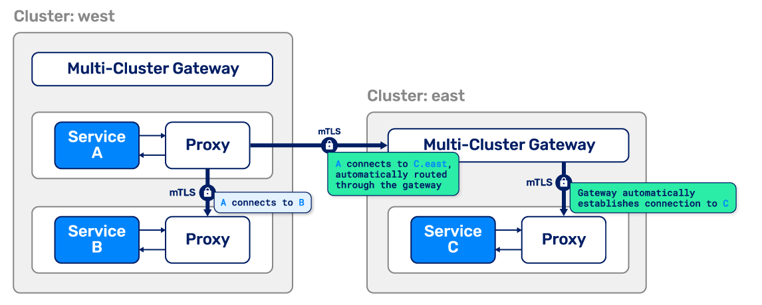
Linkerd 2.8: seamless, secure multi-cluster Kubernetes
Connects Kubernetes services across cluster boundaries in a way that's secure, fully transparent to the application, and independent of network topology.
Unified trust domain across all clusters
Separate failure domains so there's no SPOF (single point of failure)
Works over the open Internet so no difficult L3/L4 requirements
A unified communication model with in-cluster communication

Slide 13
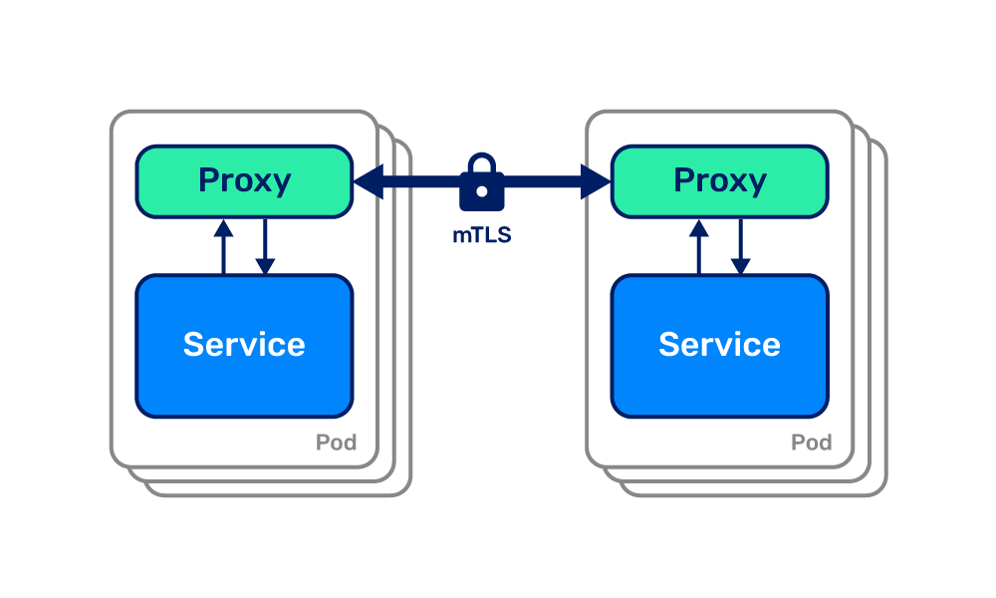
Linkerd 2.9: mTLS for all
Extends zero-config mutual TLS support to TCP connections, allowing all traffic to be transparently encrypted and authenticated.
ARM support allows Linkerd to run anywhere
Multi-core proxy runtime adds throughput and concurrency
Service topologies introduce routing preferences on a per-node basis
Bring your own Prometheus making the control plane lighter

Slide 14
Linkerd 2.10: Modularized control plane with extensions
Extensions make the control plane modularized: install just the components that you want.
Default control plane: just the bare minimum for operation (200mb)
viz extension: metrics stack (Prometheus, Grafana, dashboard)
jaeger extension: distributed tracing
multi-cluster extension: multi-cluster machinery
Extensions can also come from third parties, and fit seamlessly into linkerd install, linkerd check, etc.
In addition to extensions, 2.10 includes opaque ports to proxy without protocol detection, extends multi-cluster to all TCP connections, and lots more.

Slide 15
Automatic mutual Transport Layer Security (mTLS).
What is it ?
Linkerd automatically enables mutual Transport Layer Security (TLS) for all communication between meshed applications by establishing and authenticating private TLS connections between Linkerd proxies.
That is to say, Linkerd can add authenticated, encrypted communication to your app with very little work on your part.Which in hand means since the control plane runs on the data plane communication between Linkerd’s control plane components is also secured with mTLS..
How it works?
Control plane issues TLS certificates to proxies, which are scoped to the Kubernetes ServiceAccount of the containing pod and automatically rotated every 24 hours. The proxies use these certificates to encrypt and authenticate TCP traffic to other proxies. To do this, Linkerd maintains a set of credentials in the cluster: a trust anchor, and an issuer certificate and private key.

Slide 16
Automatic Proxy Injection
Automatically adds the data plane proxy to pods when the linkerd.io/inject: enabled annotation is present on a namespace or any workloads, such as deployments or pods. This is known as “proxy injection”.
Proxy injection is implemented as a Kubernetes admission webhook. This means that the proxies are added to pods within the Kubernetes cluster itself, regardless of whether the pods are created by kubectl, a CI/CD system, or any other system.
For each pod, two containers are injected:
linkerd-init, a Kubernetes Init Container that configures iptables to automatically forward all incoming and outgoing TCP traffic through the proxy. (Note that this container is not present if the Linkerd CNI Plugin has been enabled.)
linkerd-proxy, the Linkerd data plane proxy itself.
Injection can be made on the client side (linkerd inject --manual), but having injection to the cluster side makes it easier to ensure that the data plane is always present and configured correctly, regardless of how pods are deployed.

Slide 17



CNI Plugin
Linkerd installs can be configured to run a CNI plugin that rewrites each pod’s iptables rules automatically. Rewriting iptables is required for routing network traffic through the pod’s linkerd-proxy container. When the CNI plugin is enabled, individual pods no longer need to include an init container that requires the NET_ADMIN capability to perform rewriting. This can be useful in clusters where that capability is restricted by cluster administrators.
all subsequent installs that include a linkerd-proxy container (including the Linkerd control plane), no longer need to include the linkerd-init container. Omission of the init container is controlled by the --linkerd-cni-enabled flag at control plane install time

Slide 18

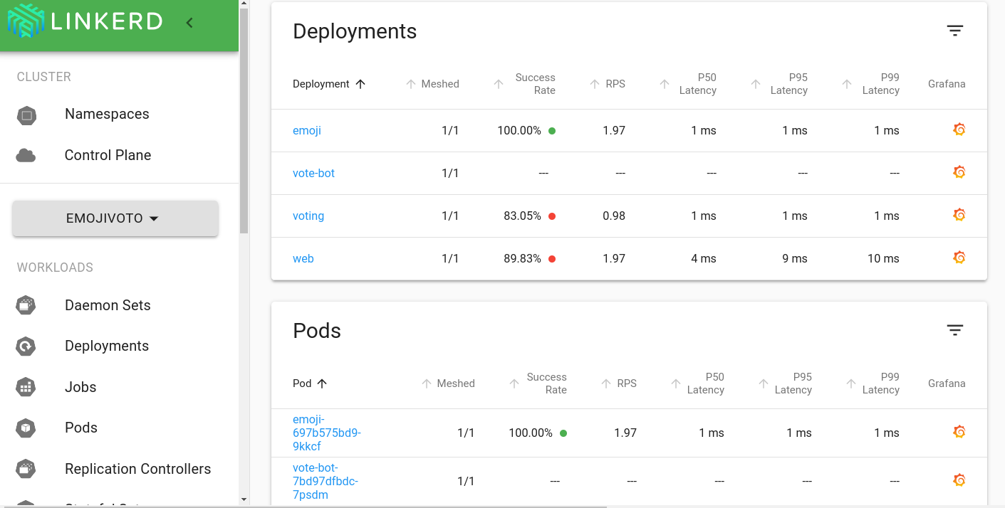
Dashboard and Grafana
Prerequisite viz extension:
The Dashboard shows:
“Golden” metrics (success rate, requests/second and latency), visualize service dependencies and understand the health of specific service routes. One way to pull it up is by running linkerd viz dashboard from the command line.

Slide 19
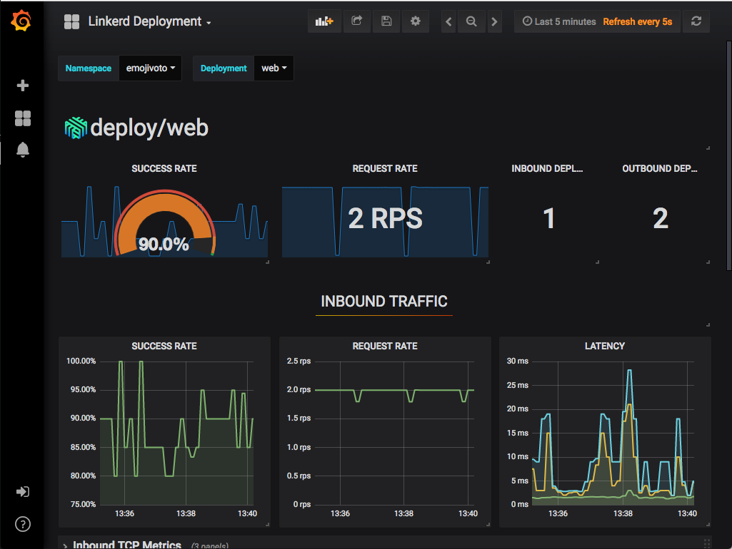
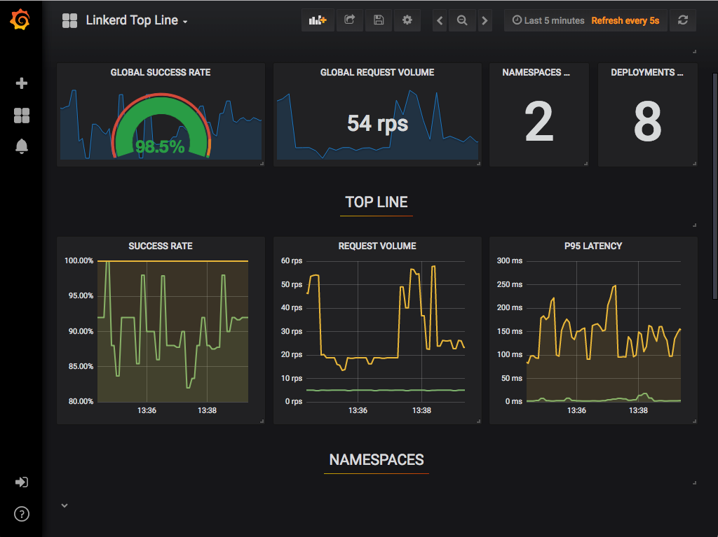
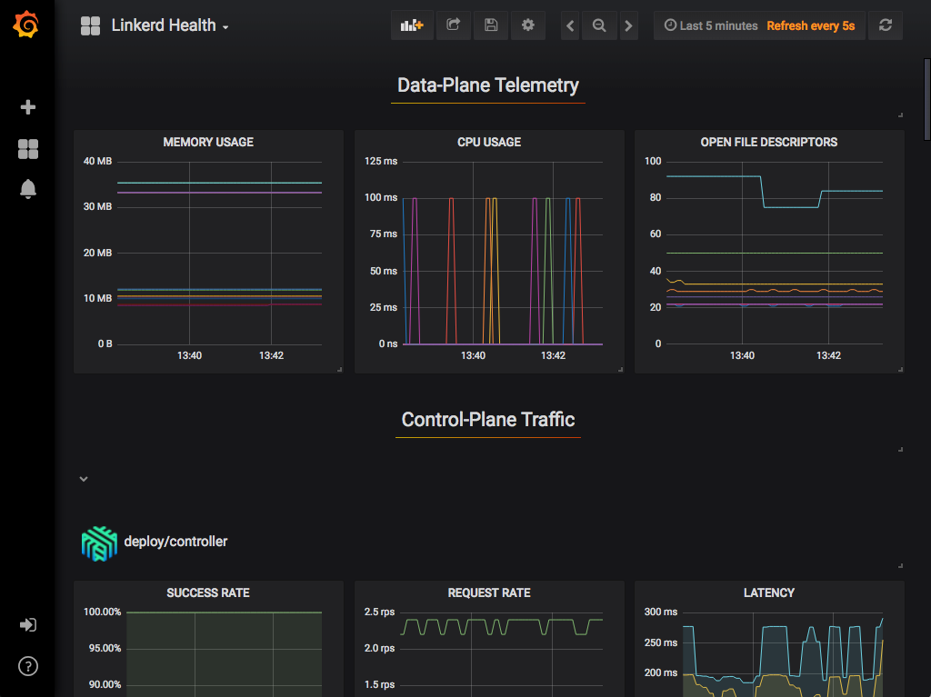
What Graphana provides
out of the box:
-Top Line Metrics
-Deployment Detail
-Pod Detail
-Linkerd Health

Slide 20
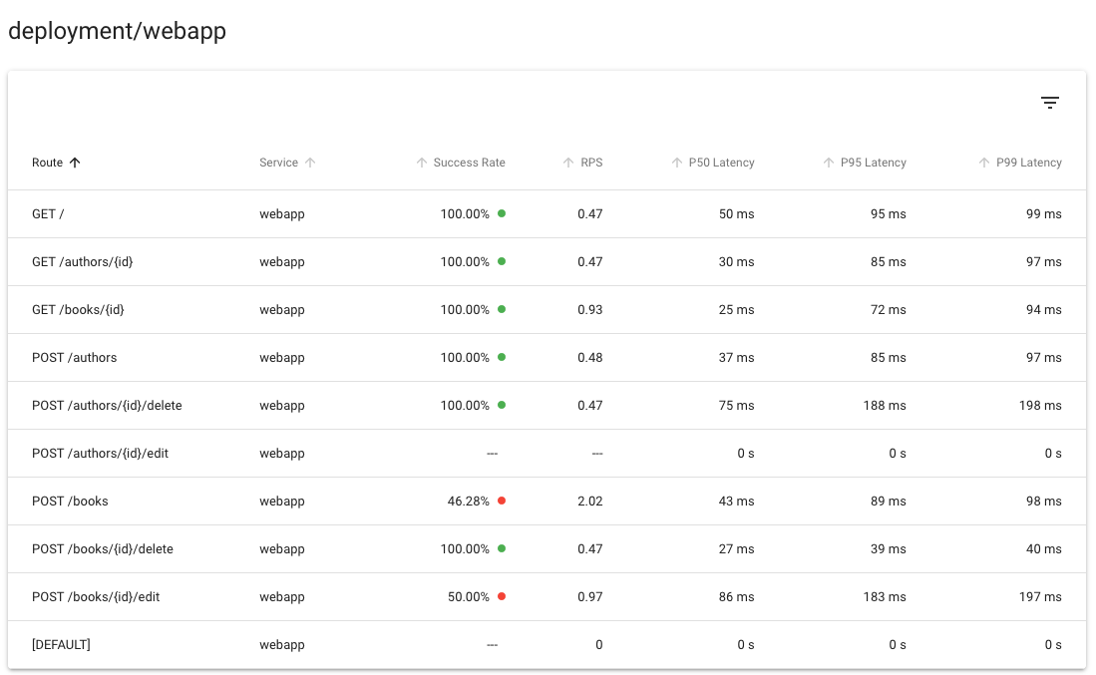
Distributed Tracing
Used for identifying bottlenecks, evaluating performance and understanding latency cost of components in your system.
When Linkerd gets a tracing header in a proxied HTTP request Linkerd will emit a trace span for that request. If paired with software to collect, store, analyze this data it will provide marginable insight into the mesh's behavior
Linkerd can provide golden metrics
per service and per route,
again without requiring
distributed tracing or
any other such application modification:
Unlike most of the features of Linkerd, distributed tracing requires both code changes and configuration

Slide 21
Fault Injection & Ingress & HTTP, HTTP/2, gRPC Proxying
A form of chaos engineering where the rate of errors of a service is artificially increased to measure the size of the impact it makes on the system as a whole. Linkerd does this without any service code changes, only with a tiny bit of configuration. In contrast doing this the traditional way would require a modification of your service's code, in a way which adds a fault injection library that does the actual work.
Linkerd is designed to work alongside your ingress controller of choice; For reasons of simplicity, Linkerd does not provide its own ingress controller.
All TCP connections can be proxied by Linkerd and would automatically enable advanced features (metrics, load balancing, retries etc.) for HTTP, HTTP/2 and gRPC connections. For GO grpc-go version 1.3 or later is obligatory, as for JS version 1.1.0 of grpc-js overcomes a bug where a port is not included in the authority when making requests.

Slide 22

High Availability
For production workloads, Linkerd’s control plane can run in high availability (HA) mode.
This mode:
Runs three replicas of critical control plane components.
Sets production-ready CPU and memory resource requests on control plane components.
Sets production-ready CPU and memory resource requests on data plane proxies
Requires that the proxy auto-injector be functional for any pods to be scheduled.
Sets anti-affinity policies on critical control plane components to ensure, if possible, that they are scheduled on separate nodes and in separate zones by default.

Slide 23
Load Balancing
Linkerd uses an algorithm called EWMA, or exponentially weighted moving average, to automatically send requests to the fastest endpoints. This load balancing can improve end-to-end latencies.
For HTTP, HTTP/2, and gRPC connections, Linkerd automatically load balances requests across all destination endpoints without any configuration required. (For TCP connections, Linkerd will balance connections.)
For HTTP, HTTP/2, and gRPC connections, Linkerd automatically load balances requests across all destination endpoints without any configuration required. (For TCP connections, Linkerd will balance connections.)
Linkerd’s load balancing is particularly useful for gRPC (or HTTP/2) services in Kubernetes, for which Kubernetes’s default load balancing is not effective.

Slide 24
Multi-cluster communication
Linkerd can connect Kubernetes services across cluster boundaries in a way that is secure, fully transparent to the application, and independent of network topology. This multi-cluster capability is designed to provide:
-A unified trust domain. The identity of source and destination workloads are validated at every step, both in and across cluster boundaries.
-Separate failure domains. Failure of a cluster allows the remaining clusters to function.
-Support for heterogeneous networks. Since clusters can span clouds, VPCs, on-premises data centers, and combinations thereof, Linkerd does not introduce any L3/L4 requirements other than gateway connectivity.
-A unified model alongside in-cluster communication. The same observability, reliability, and security features that Linkerd provides for in-cluster communication extend to cross-cluster communication.

Slide 25
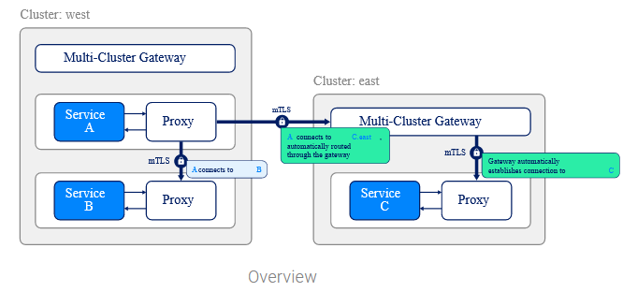
How it works:
Multi-cluster support works by “mirroring” service information between clusters. Because remote services are represented as Kubernetes services, the full observability, security and routing features of Linkerd apply uniformly to both in-cluster and cluster-calls, and the application does not need to distinguish between those situations.

Slide 26
This functionality is implemented by two components: a service mirror and a gateway. The service mirror component watches a target cluster for updates to services and mirrors those service updates locally on a source cluster. This provides visibility into the service names of the target cluster so that applications can address them directly. The multi-cluster gateway component provides target clusters a way to receive requests from source clusters. (This allows Linkerd to support hierarchical networks.)

Slide 27
Retries and Timeouts & Service profiles
-Automatic retries are one the most powerful and useful mechanisms a service mesh has for gracefully handling partial or transient application failures. If implemented incorrectly retries can amplify small errors into system wide outages.
-Timeouts work hand in hand with retries. Once requests are retried a certain number of times, it becomes important to limit the total amount of time a client waits before giving up entirely. Imagine a number of retries forcing a client to wait for 10 seconds..
Traditionally, when performing retries, you must specify a maximum number of retry attempts before giving up. Unfortunately, there are two major problems with configuring retries this way:
-Choosing a maximum number of retry attempts is a guessing game
-Systems configured in such a way can be at risk of a retry storm

Slide 28
Retries and Timeouts & Service profiles
A retry storm begins when one service starts (for any reason) to experience a larger than normal failure rate. This causes its clients to retry those failed requests. The extra load from the retries causes the service to slow down further and fail more requests, triggering more retries. If each client is configured to retry up to 3 times, this can quadruple the number of requests being sent! To make matters even worse, if any of the clients’ clients are configured with retries, the number of retries compounds multiplicatively and can turn a small number of errors into a self-inflicted denial of service attack.
To avoid the problems of retry storms and arbitrary numbers of retry attempts, retries are configured using retry budgets. Linkerd keeps track of the ratio between regular requests and retries and keeps this number below a configurable limit. For example, you may specify that you want retries to add at most 20% more requests. Linkerd will then retry as much as it can while maintaining that ratio.
Configuring retries is always a trade-off between improving success rate and not adding too much extra load to the system.
Service profiles (a custom Kubernetes resource (CRD)) allow you to define a list of routes for the service. Each route uses a regular expression to define which paths should match that route. Defining a service profile enables Linkerd to report per-route metrics and also allows you to enable per-route features such as retries and timeouts.

Slide 29
TCP Proxying and Protocol Detection
Linkerd is capable of proxying all TCP traffic, including TLS connections, WebSockets, and HTTP tunneling.
In most cases, Linkerd can do this without configuration. To do this, Linkerd performs protocol detection to determine whether traffic is HTTP or HTTP/2 (including gRPC). If Linkerd detects that a connection is HTTP or HTTP/2, Linkerd will automatically provide HTTP-level metrics and routing.
If Linkerd cannot determine that a connection is using HTTP or HTTP/2, Linkerd will proxy the connection as a plain TCP connection, applying mTLS and providing byte-level metrics as usual.
Note
Client-initiated HTTPS will be treated as TCP, not as HTTP, as Linkerd will not be able to observe the HTTP transactions on the connection.

Slide 30

Telemetry and Monitoring
To gain access to Linkerd’s observability features you only need to install the Viz extension:
Linkerd’s telemetry and monitoring features function automatically, without requiring any work on the part of the developer. These features include:
Recording of top-line (“golden”) metrics (request volume, success rate, and latency distributions) for HTTP, HTTP/2, and gRPC traffic.
Recording of TCP-level metrics (bytes in/out, etc) for other TCP traffic.
Reporting metrics per service, per caller/callee pair, or per route/path (with Service Profiles).
Generating topology graphs that display the runtime relationship between services.
Live, on-demand request sampling.
This data can be consumed in several ways:
Through the Linkerd CLI, e.g. with linkerd viz stat and linkerd viz routes.
Through the Linkerd dashboard, and pre-built Grafana dashboards.
Directly from Linkerd’s built-in Prometheus instance

Slide 31
Traffic Split (canaries, blue/green deploys)
A functionality which allows you to dynamically shift arbitrary portions of traffic destined for a Kubernetes service to a different destination service. This feature can be used to implement sophisticated rollout strategies such as canary deployments and blue/green deployments, for example, by slowly easing traffic off of an older version of a service and onto a newer version.
By combining traffic splitting with Linkerd’s metrics, it is possible to accomplish even more powerful deployment techniques that automatically take into account the success rate and latency of old and new versions.
Examples of traffic split application is fault injection and canary release(2).
This functionality is exposed via The Service Mesh Interface TrafficSplit API.
In order to use this feature, create a Kubernetes resource as described in the TrafficSplit spec and Linkerd will take care of the rest.
(2)Canary release is a technique to reduce the risk of introducing a new software version in production by slowly rolling out the change to a small subset of users before rolling it out to the entire infrastructure and making it available to everybody.

Slide 32
Linkerd vs Istio
A common question! It comes down to: what do you need in a service mesh?
Linkerd
Theme: the bare minimum to build a secure, reliable, flexible Kubernetes platform.
Pros:
Much easier to understand and operate
Smaller, lighter, faster
Secure by default
Kubernetes native
Cons:
Only works on Kubernetes
Istio
Theme: Every situation no matter the complexity.
Pros:
Has all the features
Your boss has read a blog post about it
No one ever got fired for choosing IBM
Supports complex use cases
Cons:
Big, complex, hard to operate

Slide 33
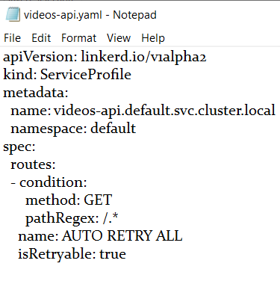
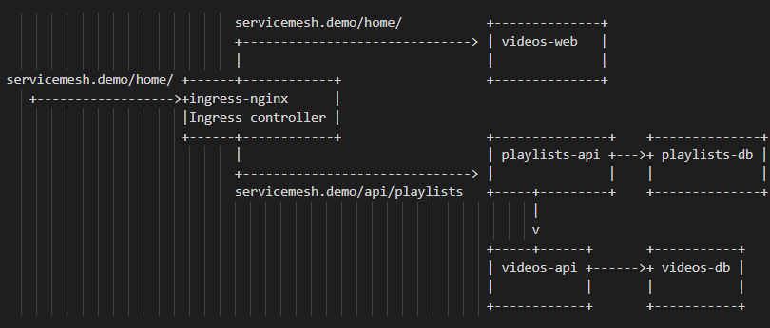

Slide 34
vs := []videos{} for vi := range playlists[pi].Videos { v := videos{} videoResp, err := http.Get("http://videos-api:10010/" + playlists[pi].Videos[vi].Id) if err != nil { fmt.Println(err)
Break }
Playlists api
package main
import (
"net/http"
"github.com/julienschmidt/httprouter"
log "github.com/sirupsen/logrus"
"encoding/json"
"fmt"
"os"
"bytes"
"io/ioutil"
"context"
"github.com/go-redis/redis/v8"
)
var environment = os.Getenv("ENVIRONMENT")
var redis_host = os.Getenv("REDIS_HOST")
var redis_port = os.Getenv("REDIS_PORT")
var ctx = context.Background()
var rdb *redis.Client
func main() {
router := httprouter.New()
router.GET("/", func(w http.ResponseWriter, r *http.Request, p httprouter.Params){
cors(w)
playlistsJson := getPlaylists()
playlists := []playlist{}
err := json.Unmarshal([]byte(playlistsJson), &playlists)
if err != nil {
panic(err)
}
//get videos for each playlist from videos api
for pi := range playlists {

Slide 35
defer videoResp.Body.Close() video, err := ioutil.ReadAll(videoResp.Body) if err != nil { panic(err)
} err = json.Unmarshal(video, &v) if err != nil { panic(err) }
vs = append(vs, v)
}
playlists[pi].Videos = vs
}
playlistsBytes, err := json.Marshal(playlists)
if err != nil {
panic(err)
}
reader := bytes.NewReader(playlistsBytes)
if b, err := ioutil.ReadAll(reader); err == nil {
fmt.Fprintf(w, "%s", string(b))
}})
r := redis.NewClient(&redis.Options{
Addr: redis_host + ":" + redis_port,
DB: 0,
})
rdb = r
fmt.Println("Running...")
log.Fatal(http.ListenAndServe(":10010", router))
}
func getPlaylists()(response string){
playlistData, err := rdb.Get(ctx, "playlists").Result()
if err != nil {
fmt.Println(err)
fmt.Println("error occured retrieving playlists from Redis")
return "[]"
}
return playlistData
}

Slide 36
type playlist struct {
Id string `json:"id"`
Name string `json:"name"`
Videos []videos `json:"videos"`
} type videos struct {
Id string `json:"id"`
Title string `json:"title"`
Description string `json:"description"`
Imageurl string `json:"imageurl"`
Url string `json:"url"`
} type stop struct { error
}
func cors(writer http.ResponseWriter) () {
if(environment == "DEBUG"){
writer.Header().Set("Access-Control-Allow-Methods", "POST, GET, OPTIONS, PUT, DELETE")
writer.Header().Set("Access-Control-Allow-Headers", "Content-Type, Content-Length, Accept-Encoding, X-CSRF-Token, Authorization, accept, origin, Cache-Control, X-Requested-With, X-MY-API-Version")
writer.Header().Set("Access-Control-Allow-Credentials", "true")
writer.Header().Set("Access-Control-Allow-Origin", "*")
}
}

Slide 37
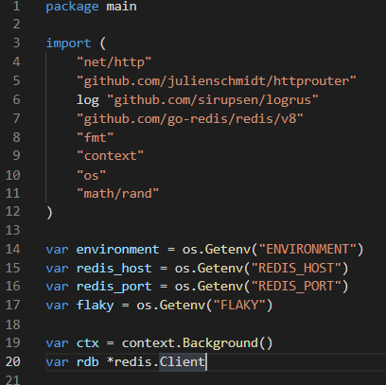
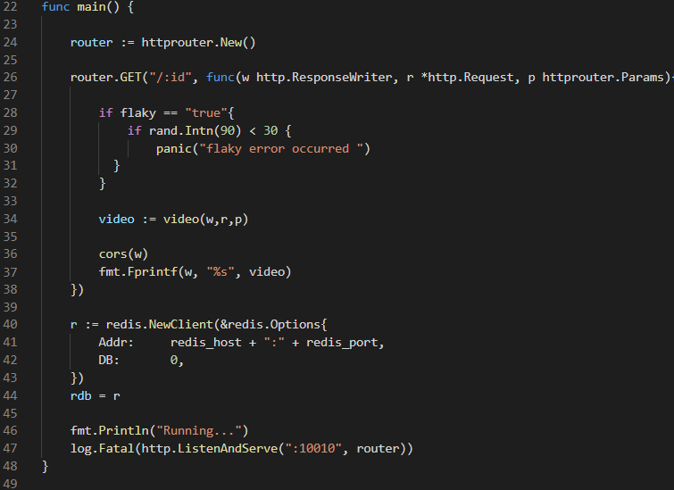
Videos.api

Slide 38
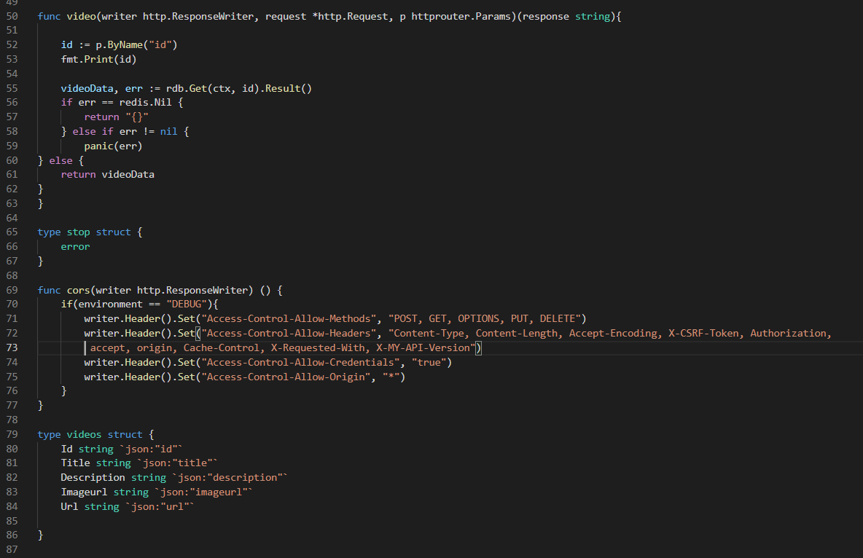

Slide 39
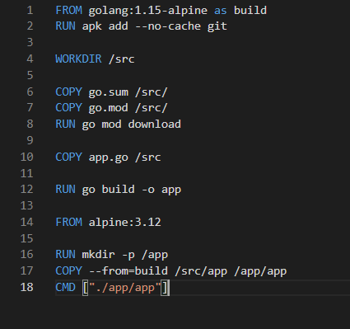
Dockerfile for videos and playlists api

